Slide 1

ECE 4099 : Capstone Project [Review – 2]
CAN Data Logger for X-Ray Collimator
Internal Guide
Dr. Sofana Reka S
SENSE, VIT – Chennai
External Guide
Ms. Shamlin Sunny (SHS TI TC ITT)
Technology Head ITT India
Presented By:
K Manoj Madhav
15BEC1078

Slide 2
OBJECTIVE
To log CAN Data from Imaging Equipment to remote view any issue avoiding the need for physical intervention.
CAN Protocol issues at present viewed using CAN Analyzer.
Continuous Data Logging from X-Ray Collimator.
Dosimeter data acquisition.
Visualization of Acquired Data.

Slide 3

PROJECT TIMELINE :
Introduction to various Siemens Diagnostic/Imaging Equipment
Workflow pain-points (Disadvantages) in various departments
Description of the technologies used (Comm. Protocols)
Proprietary Materials and White-Papers to study
Identification of problem w.r.t equipment/workflow
Stage 1 (Introduction) Jan ‘19 – Feb ’19
Problem discussion with concerned team (AT– Advanced Therapy)
Solution concept brainstorming - Mr. Pradeep P A (R&D –AT)
Implementation of code in QNX system
Check hardware compatibility (with existing collimators)
Troubleshoot Errors
Final demonstration of Proof Of Concept to Mr. Mathew Abraham
Stage 2 (Implementation) Feb ‘19 – Apr ’19
Check feasibility of implementation (Retrofitability)
Send proposal to R&D Erlangen (Germany)
Documentation & Archiving
Stage 3 (Documentation) Apr ‘19 – May ’19

Slide 4
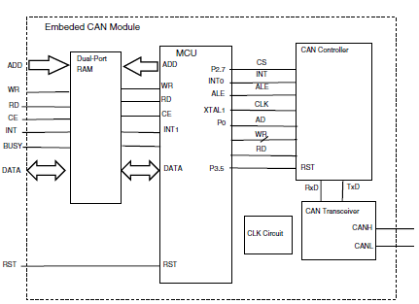
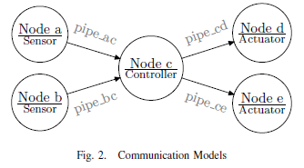
LITERATURE SURVEY
An Embedded CAN-BUS Communication Module for Measurement and Control System.
Xiaoming Li, Mingxiong Li, Mechatronics Institute, Faculty of Mechanical Engineering and Automation, Zhejiang Sci-Tech University, Hangzhou, China
INSPEC Accession Number: 11701030
DOI: 10.1109/ICEEE.2010.5661248
The motivation to design such CAN module is try to ease the development of CAN-BUS based embedded applications. With the CAN module, the engineers do not have to understand all aspects of CAN protocol, CAN controllers and CAN transceivers, therefore an industry automation application can be built conveniently.
Communication is the transmission of data. In the Measurement
and Control (MAC) system, the nodes can be categorized
into different classes such as sensor, controller and actuator,
according to their role in processing the data (figure 2). From
the angle of application, the data is transferred from one node
to another sequentially, therefore it is can be considered that
the data is transported through a pipe.

Slide 5
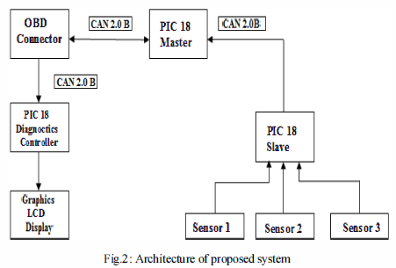
LITERATURE SURVEY
Embedded On-Board Diagnostics System Using CAN Protocol.
Pallavi R. Burje, Kailash J. Karande, Amol B. Jagadale
INSPEC Accession Number: 14737340
DOI: 10.1109/ICCSP.2014.6949940
Embedded on-board diagnostics system consists of master slave communication implemented through CAN network. Sensors are interfaced to slave microcontroller for monitoring various
parameters of system.
Master microcontroller produces diagnostic trouble codes
(DTC) to indicate the causes of the fault produced in
parameters of system. It is user friendly system with LCD
interface though which user can view parameter values,
warning for different parameters of the system.

Slide 6

COMPARISON WITH RELATED TECHNOLOGY
Current CAN Analyzer used to monitor high-speed can networks :
Microchip APGDT002
Internal Major Components of APGDT002:
MAX 3378E – Level Translator (for Multi-Voltage Systems)
MCP 2551 – High-Speed CAN Transceiver
PIC 18F2680 – µC receiving serial data from CAN Transceiver; Alternating CAN Data w.r.t to trigger signals given as input
PIC 18F2550 – µC controlling internal status lights

Slide 7
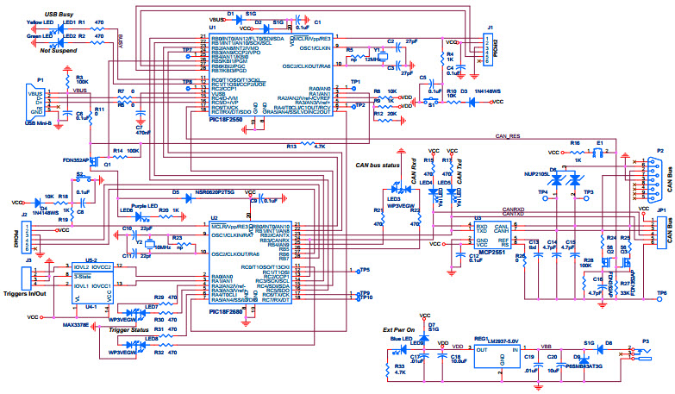
COMPARISON WITH RELATED TECHNOLOGY

Slide 8
APPLICATION OF SCIENTIFIC PRINCIPLE – (VIABLE SOLUTION)
Async. serial comm. of CAN Data to µCs via (USB to I2C)
8-bit to USB Parallel Converter

Slide 9
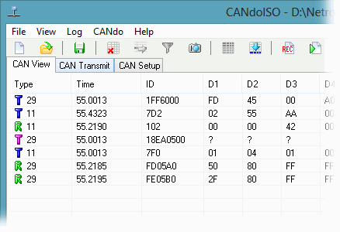
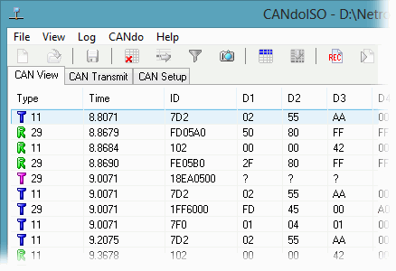
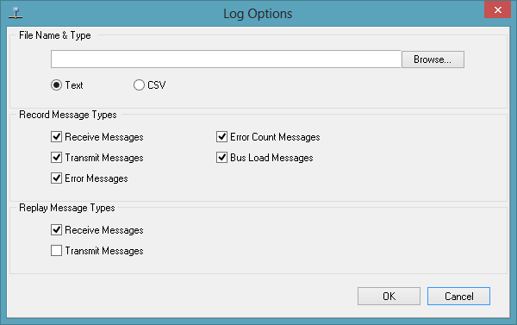
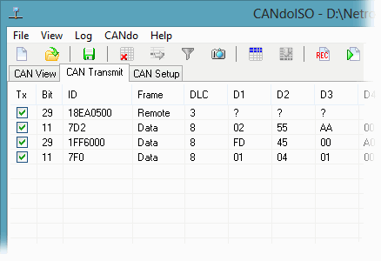
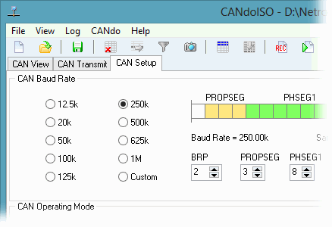
WORKDONE
Training on Visualization and understanding of CAN Data from X-Ray Collimator.
CAN - FIXED MODE
CAN - CYCLIC MODE
CAN - LOG
CAN - TRANSMIT
CAN - SETUP

Slide 10
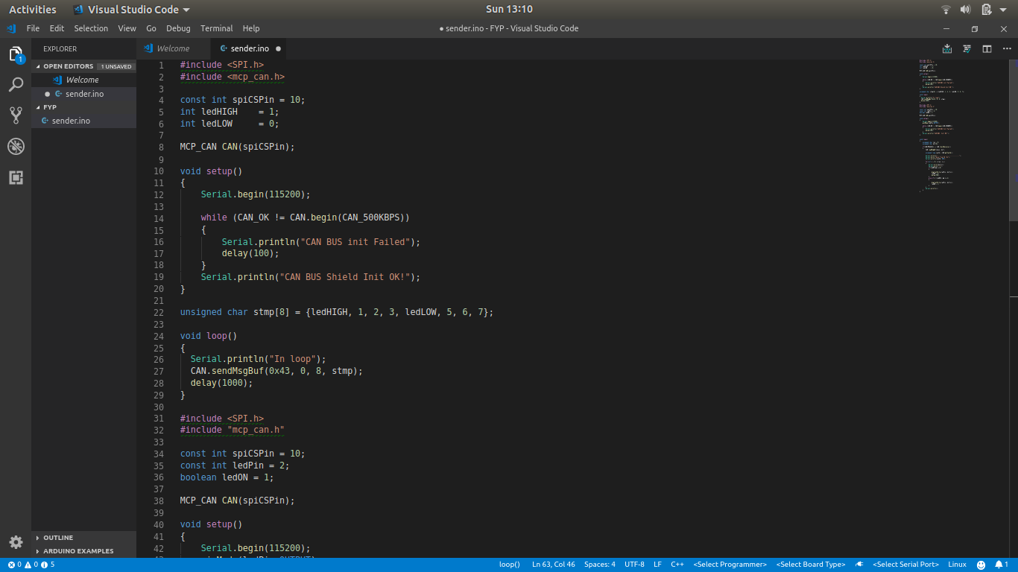
BASIC CAN PROTOCOL CODE

Slide 11
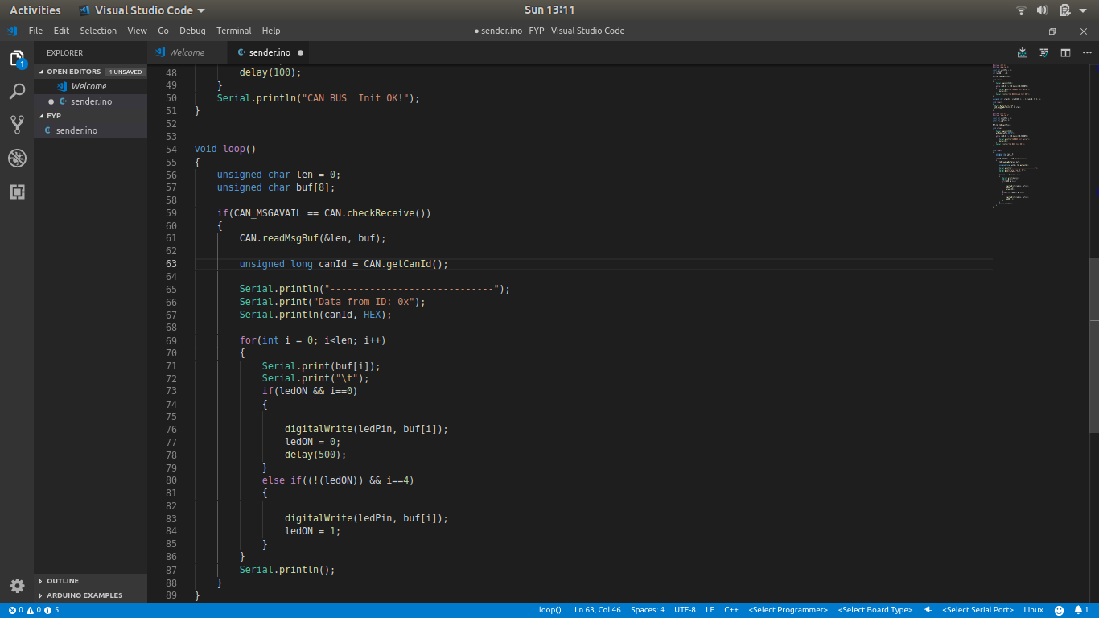
BASIC CAN PROTOCOL CODE (contd.)

Slide 12
PROJECT TIMELINE :
Introduction to various Siemens Diagnostic/Imaging Equipment
Workflow pain-points (Disadvantages) in various departments
Description of the technologies used (Comm. Protocols)
Proprietary Materials and White-Papers to study
Identification of problem w.r.t equipment/workflow
Stage 1 (Introduction) Jan ‘19 – Feb ’19
Problem discussion with concerned team (AT– Advanced Therapy)
Solution concept brainstorming - Mr. Pradeep P A (R&D –AT)
Implementation of code in QNX system
Check hardware compatibility (with existing collimators)
Troubleshoot Errors
Final demonstration of Proof Of Concept to Mr. Mathew Abraham
Stage 2 (Implementation) Feb ‘19 – Apr ’19
Check feasibility of implementation (Retrofitability)
Send proposal to R&D Erlangen (Germany)
Documentation & Archiving
Stage 3 (Documentation) Apr ‘19 – May ’19

Slide 13
REFERENCES:
An Embedded CAN-BUS Communication Module for Measurement and Control System
Xiaoming Li, Mingxiong Li, Mechatronics Institute, Faculty of Mechanical Engineering
and Automation, Zhejiang Sci-Tech University, Hangzhou, China
Embedded On-Board Diagnostics System Using CAN Protocol
Pallavi R. Burje, Kailash J. Karande, Amol B. Jagadale
Supporting Security Protocols on CAN-Based Networks
Gedare Bloom, Gianluca Cena, Ivan Cibrario Bertolotti, Tingting Hu, Adriano Valenzano
Howard University, 2300 6th St NW, Washington, DC 20059, USA
https://www.can-cia.org/can-knowledge/can/systemdesign-can-physicallayer/
https://ww1.microchip.com/downloads/en/DeviceDoc/51848B.pdf

Slide 14

Thank you

